Slide 1
AI-Based Smart Medicine Reminder and Dispensing System
Name 1 - Roll Number 1
Name 2 - Roll Number 2
Name 3 - Roll Number 3

Slide 2
Abstract
The AI-Based Smart Medicine Reminder and Dispensing System is designed to automate medication management for individuals requiring regular medicine intake. The proposed system stores predefined medication schedules and automatically dispenses the appropriate medicine compartment at the scheduled time while generating audible and visual reminders. Artificial intelligence can be utilized to analyze medication adherence patterns, predict missed doses, and generate health insights for caregivers. The system integrates embedded controllers, servo-based dispensing mechanisms, RTC modules for accurate scheduling, sensors for dispensing confirmation, and IoT connectivity for remote monitoring. The proposed solution minimizes medication errors, enhances treatment compliance, and supports elderly patients living independently. By combining intelligent automation with healthcare monitoring, the project offers a reliable, cost-effective, and scalable solution suitable for homes, assisted living facilities, and healthcare institutions.

Slide 3
Problem Statement
Medication non-adherence is a major healthcare challenge, particularly among elderly individuals, patients with chronic illnesses, and those prescribed multiple medications. Missing doses, taking incorrect medicines, or consuming medicines at the wrong time can reduce treatment effectiveness and lead to severe health complications. Existing reminder solutions mainly provide notifications but do not ensure accurate dispensing. Therefore, an intelligent automated medicine dispensing system is required to improve medication adherence, reduce human errors, and support independent healthcare management.

Slide 4
Background & Literature
Healthcare automation has witnessed significant advancements through the integration of IoT, embedded systems, and artificial intelligence. Traditional medicine organizers and mobile reminder applications help users remember medication schedules but still rely heavily on manual intervention. Smart pillboxes introduced automated alarms; however, they generally lack intelligent scheduling, dispensing verification, and remote monitoring capabilities. Recent research has explored AI-enabled healthcare devices capable of analyzing medication patterns and providing personalized reminders. Nevertheless, many existing solutions remain expensive, require continuous internet connectivity, or are designed for hospital environments rather than home use. There is a growing demand for an affordable, user-friendly, and autonomous medicine management system capable of accurately dispensing medicines while providing timely reminders and maintaining medication records. This project aims to bridge these gaps by combining intelligent scheduling, automated dispensing, and real-time monitoring within a compact embedded system.

Slide 5
Objectives
Develop an intelligent system that automatically reminds users and dispenses medicines according to predefined schedules.
Improve medication adherence by reducing missed doses, dosage errors, and dependency on manual supervision.
Implement real-time scheduling, alerts, medication history tracking, and caregiver notifications.
Enable IoT-based remote monitoring with future support for AI analytics, voice assistance, and cloud healthcare integration.

Slide 6
Motivation & Need
The increasing number of patients suffering from chronic diseases has significantly increased the need for effective medication management systems. Elderly individuals often struggle to remember multiple medicine schedules, resulting in missed doses or accidental overdoses. Family members and healthcare providers cannot continuously supervise medication intake, creating a demand for automated healthcare solutions. Existing reminder applications only notify users but cannot verify whether medicines have actually been dispensed. Engineering advancements in embedded systems, IoT, and artificial intelligence provide an opportunity to develop an affordable autonomous medicine management device capable of addressing these challenges. This project demonstrates the practical application of intelligent automation in healthcare while improving patient safety, reducing caregiver workload, and supporting independent living. It also aligns with the growing trend of smart healthcare and home-based medical assistance.

Slide 7
Execution Summary
Store personalized medicine schedules securely.
Monitor time using RTC module.
Dispense medicines automatically at scheduled intervals.
Notify users and caregivers in real time.

Slide 8
Features & Functional Specifications
Automated Medicine Dispensing
Intelligent Medication Scheduling
Audio and Visual Reminder Alerts
AI-Based Medication Analytics
IoT-Based Remote Monitoring
User-Friendly Interface
Secure Medicine Storage
Expandable Modular Architecture

Slide 9
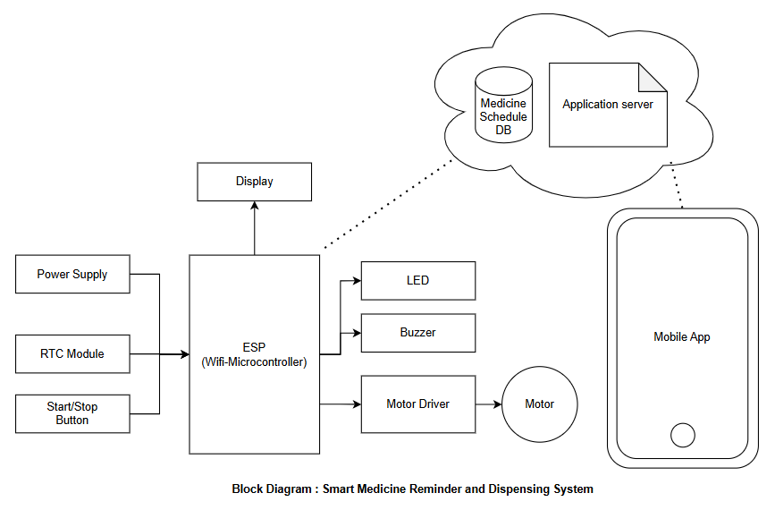
Block Diagram

Slide 10
Advantages
Improves medication adherence.
Reduces medicine dosage errors.
Supports elderly and disabled patients.
Minimizes caregiver workload.
Provides automated medicine dispensing.
Enables remote monitoring through IoT.
Generates intelligent medication reports.
Affordable and easy to operate.
Scalable for future healthcare features.
Enhances patient safety and treatment effectiveness.

Slide 11
Limitations
Requires periodic medicine refilling.
Mechanical dispensing may require calibration.
AI accuracy depends on collected medication data.
Internet connectivity required for remote monitoring.
Limited compartment capacity.
Power backup required for uninterrupted operation.
Different medicine sizes may require customized dispensing mechanisms.

Slide 12
Application
Elderly home healthcare.
Hospitals and healthcare centers.
Assisted living facilities.
Rehabilitation centers.
Chronic disease management.
Home nursing services.
Remote patient monitoring.
Smart healthcare ecosystems.
Pharmaceutical automation research.
Medical IoT educational projects.

Slide 13
References
https://eurekamag.com/research/105/916/105916150.php
https://pubmed.ncbi.nlm.nih.gov/34795001/
https://www.sciencedirect.com/science/article/pii/S2214785320377543
https://pmc.ncbi.nlm.nih.gov/articles/PMC11052969/
https://www.ijraset.com/research-paper/smart-medicine-reminder-and-healthcare-assistance-system
https://link.springer.com/article/10.1186/s40780-022-00255-w
https://arxiv.org/abs/1711.09739
https://pubmed.ncbi.nlm.nih.gov/29081939/
https://journals.sagepub.com/doi/10.1177/17298814211022539
https://cir.nii.ac.jp/crid/1360011144257032448

Slide 14
Thank You

